Slide 1
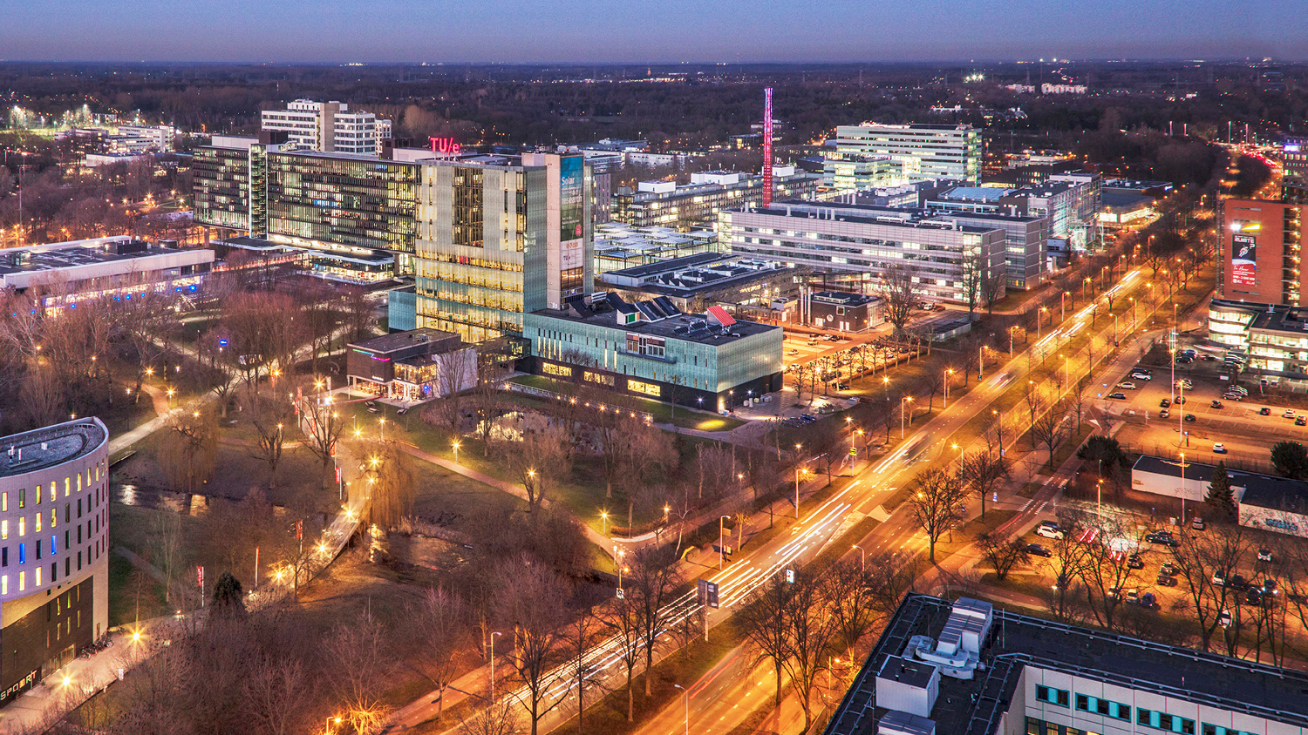
Planning
09/02/2021
Mats van der Heijden, Group 007
Combustion Engine, Mechanical Engineering

Slide 2
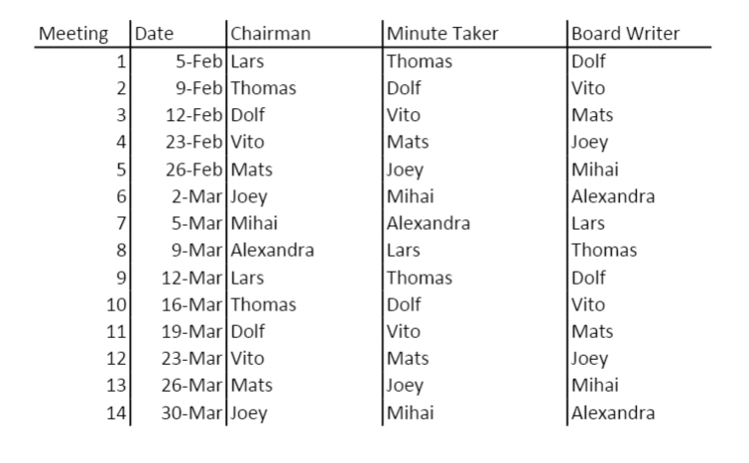
Role division

Slide 3
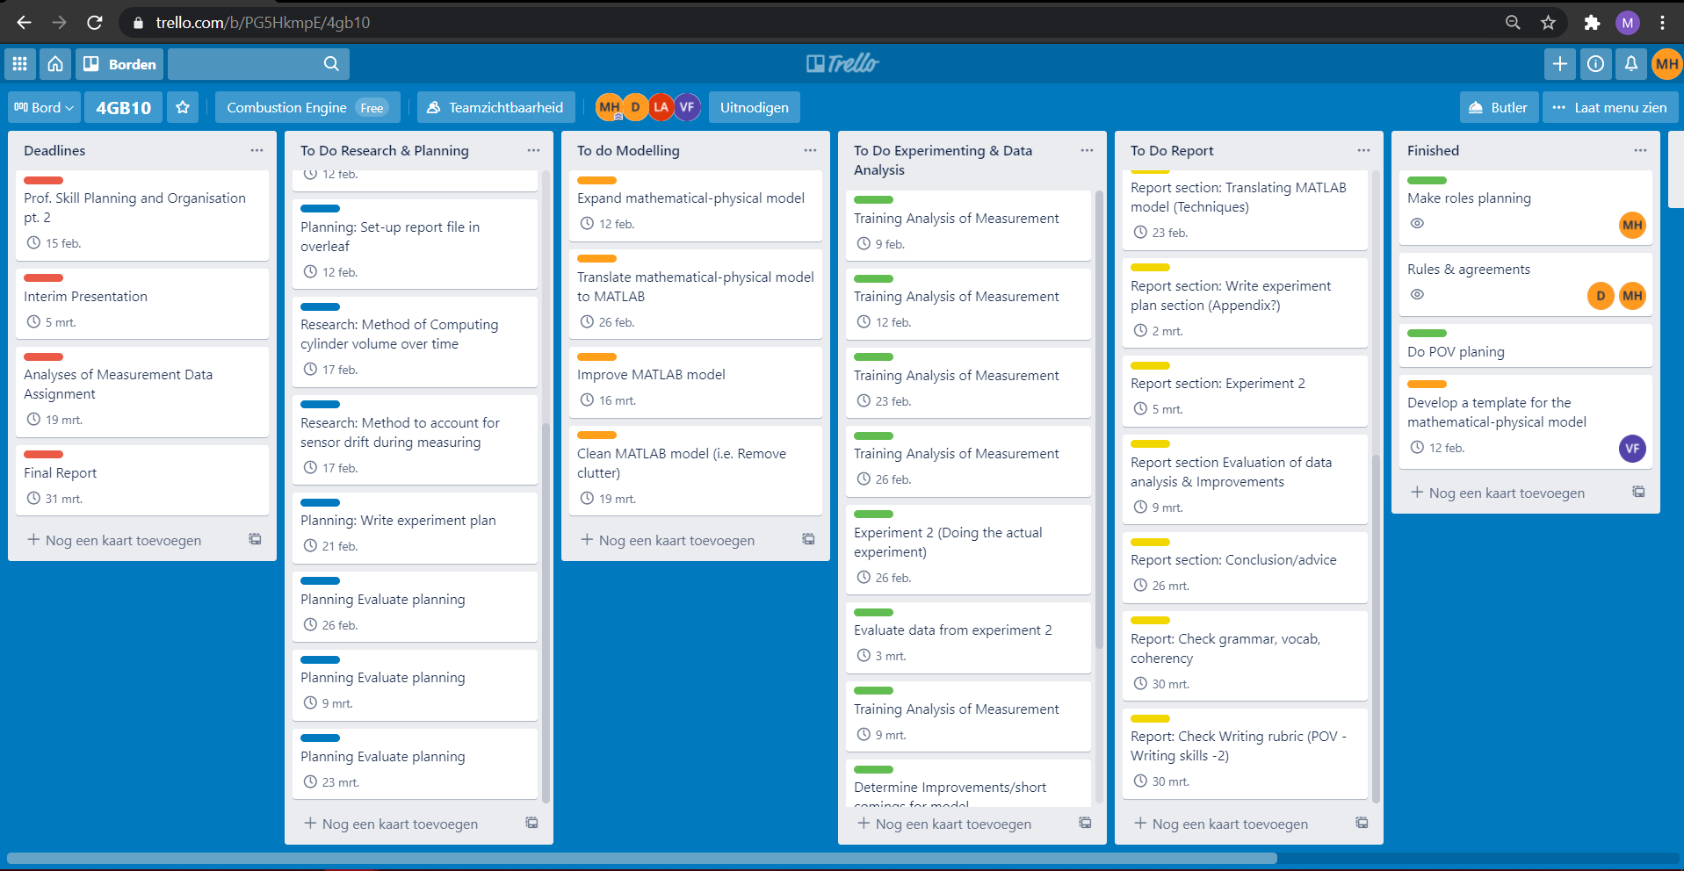
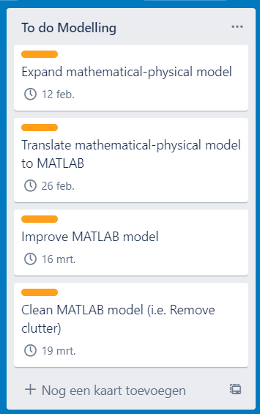
Trello Planning

